Slide 1
Modeling the Swing of Double Pendulum
Presented by:
Nabeel Ghazali 40195041
Wasay Ejaz 40185576
Hasan mahmud 40166145
Sulaiman Conain 40170570

Slide 2
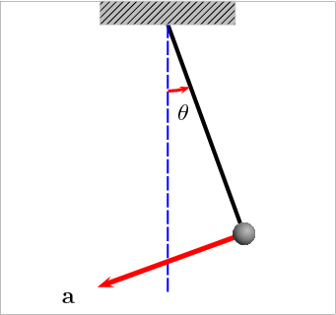
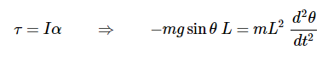
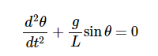
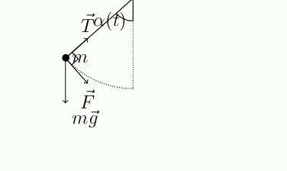
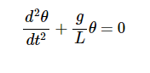
A mass suspended freely by a string or a rod
Two force:
Gravitational force (Downwards)
Tension in the string (Upwards)
The tangential component is used to derive the equation of motion
Rearranging the equation
Non-Homogeneous
Equation

Slide 3
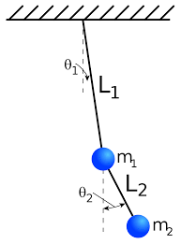

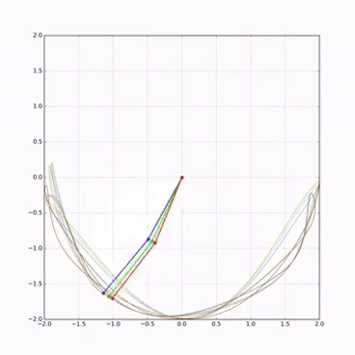
Difference between a single and double pendulum is masses
Single pendulum One mass
Double pendulum two masses
However, this is an oversimplification.
The behavior by this change of masses has a huge impact
Double pendulum is an accurate example of chaos theory also know
as the butterfly effect
Small variation such as 1/100th change in the initial angle
changes the motion of the two same pendulums

Slide 4
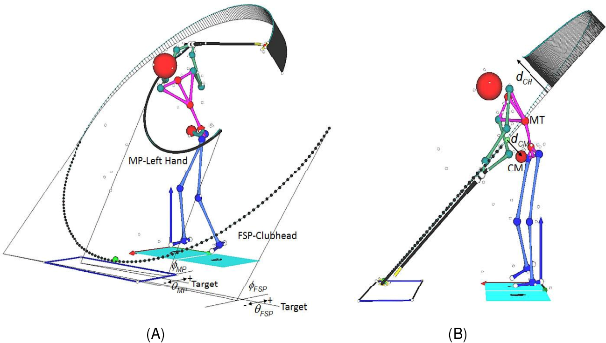
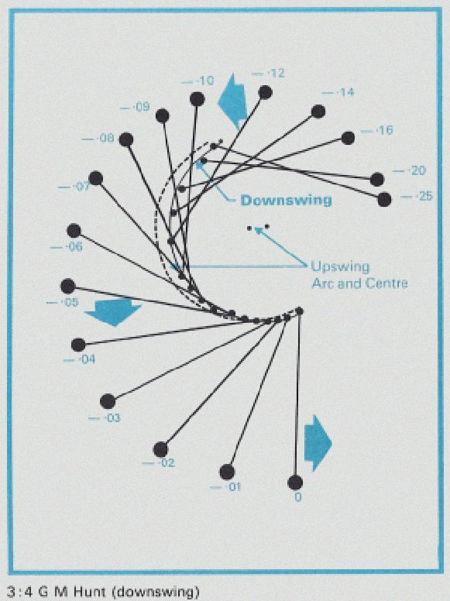
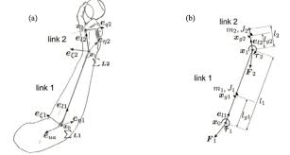
The example of the double pendulums can also be seen in real life
Golf swing
Tennis serve
Baseball pitching

Slide 5

Lagrangian Mechanics
Motion of Double Pendulum
Newtonian
Mechanics
Sophisticated formulation of classical mechanics
Classical Mechanics based on stationary action in which energies are used to describe motion
Hamiltonian
Mechanics
LAGRANGIAN
EQUATIONS
Generalized Coordinates and Momenta
Generalized Coordinates and Velocities
Summation of Kinetic and Potential Energies
Difference of Kinetic and Potential Energies

Slide 6
Model Development
Best explained with the help of two coupled ordinary second order differential equations.
Study carried out by two different methods
Lagrangian
Mechanics
Hamiltonian
Mechanics

Slide 7
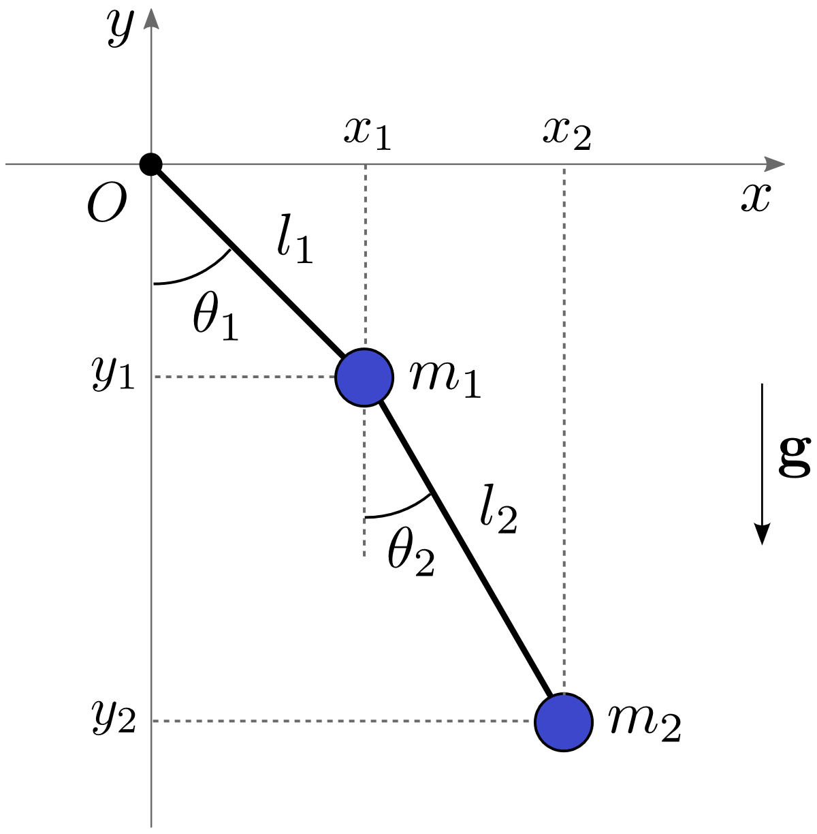
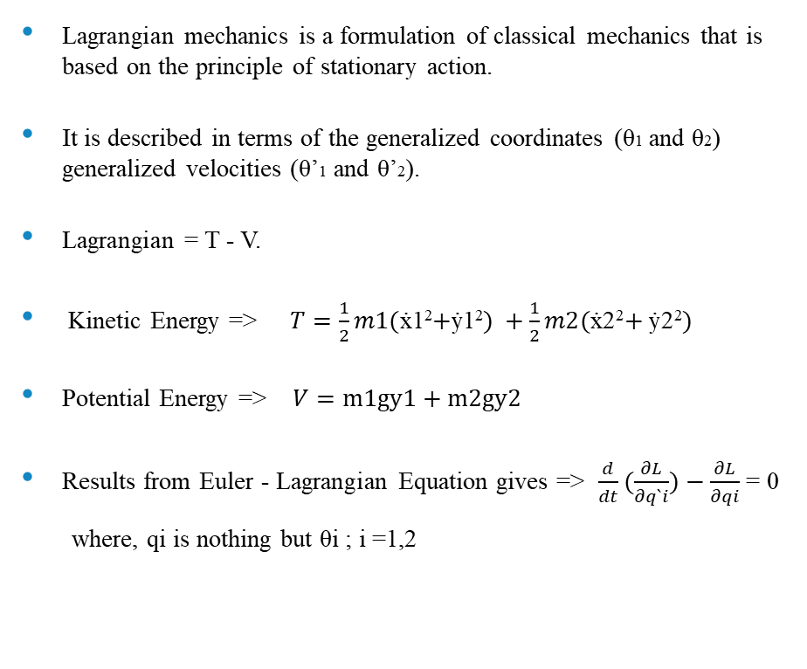
Model Development - Lagrangian
Lagrangian mechanics is a formulation of classical mechanics that is based on the principle of stationary action.
It is described in terms of the generalized coordinates (θ1 and θ2) generalized velocities (θ’1 and θ’2).
Lagrangian = T - V.
Kinetic Energy => $T=\frac{1}{2}m1($ẋ1²$+$ẏ1²$) +\frac{1}{2}m2($ẋ2²$+$ẏ2²$)$
Potential Energy => $V=m1gy1+m2gy2$
Results from Euler - Lagrangian Equation gives => $\frac{d}{dt}(\frac{∂L}{∂q`i})−\frac{∂L}{∂qi}$ = 0
where, qi is nothing but θi ; i =1,2

Slide 8
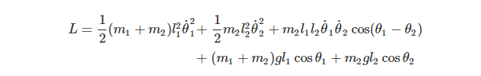
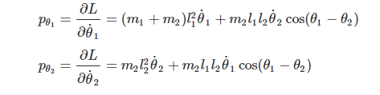
Model Development - Hamiltonian
It is a mathematically sophisticated formulation of classical mechanics.
The system is determined by the generalized coordinates (θ1, θ2) and generalized momenta (p1, p2)
It is the sum of Kinetic Energy and Potential Energy ; H = T + V

Slide 9
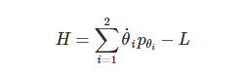
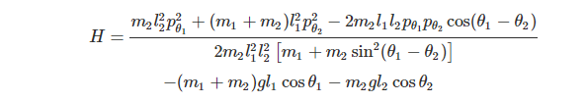
Model Development - Hamiltonian
Hamiltonian of the system is given by :
From Hamiltonian, we can obtain equation of motion of system which is equivalent to Euler Lagrange equation.
Hamiltonian equation gives first order differential equation.
We are focusing on Lagrangian equation for analysis as the Hamiltonian gives more complicated expressions that are much complex to analyze.

Slide 10
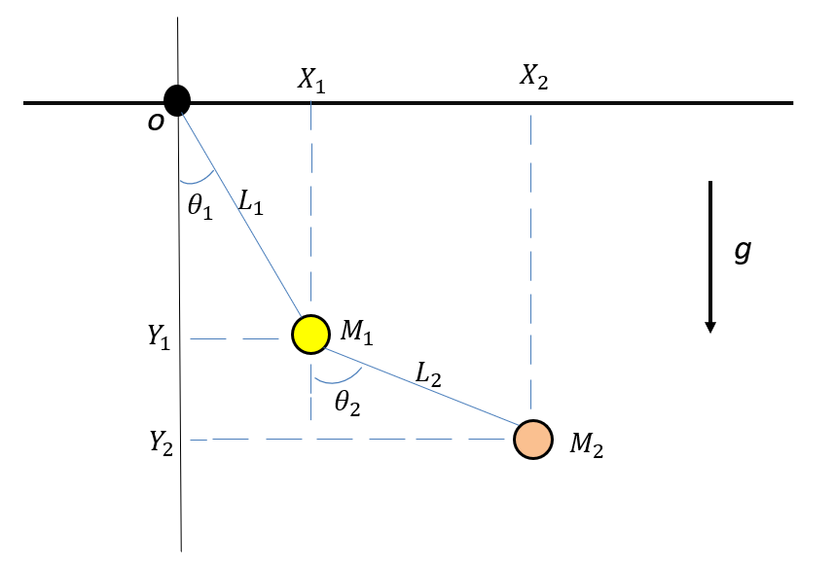
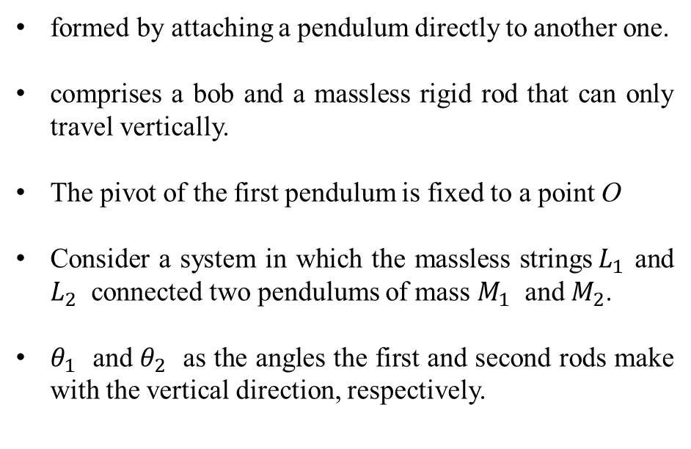
Euler Lagrange Equations Derivations
&
Simplification of Solution
formed by attaching a pendulum directly to another one.
comprises a bob and a massless rigid rod that can only travel vertically.
The pivot of the first pendulum is fixed to a point O
Consider a system in which the massless strings${ L}_{1}$ and $L_{2}$ connected two pendulums of mass $M_{1}$ and $M_{2}$.
$θ_{1}$ and $θ_{2}$ as the angles the first and second rods make with the vertical direction, respectively.

Slide 11
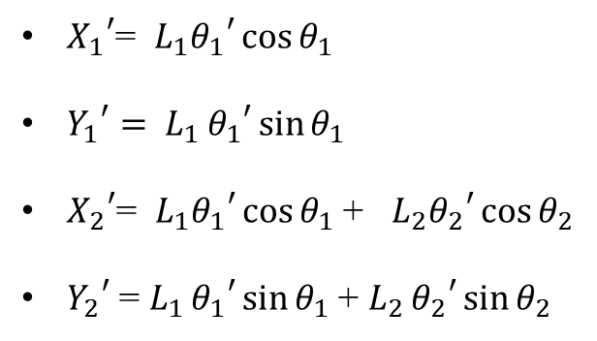
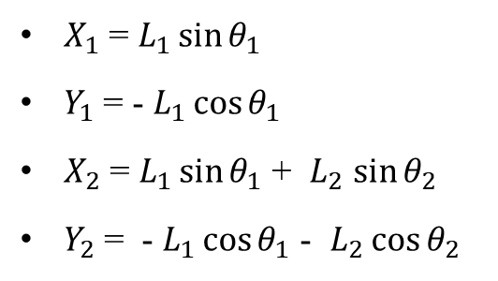
From the figure , the positions of the rods are given by:
$X_{1}$ = $L_{1}\sin{θ_{1}}$
$Y_{1}$ = - $L_{1}\cos{θ_{1}}$
$X_{2}$ = $L_{1}\sin{θ_{1}}$ + $L_{2}$ $\sin{θ_{2}}$
$Y_{2}$ = - $L_{1}\cos{θ_{1}}$ - $L_{2}\cos{θ_{2}}$
Differentiating w.r.t time
we obtain the velocities
${X_{1}}^{′}$= $L_{1}{θ_{1}}^{′}\cos{θ_{1}}$
${Y_{1}}^{′}= L_{1 }{θ_{1}}^{′}\sin{θ_{1}}$
${X_{2}}^{′}$= $L_{1}{θ_{1}}^{′}\cos{θ_{1}}$ + $L_{2}{θ_{2}}^{′}\cos{θ_{2}}$
${Y_{2}}^{′}$ = $L_{1 }{θ_{1}}^{′}\sin{θ_{1}}$ + $L_{2 }{θ_{2}}^{′}\sin{θ_{2}}$
For a double pendulum, the Lagrangian is given by L=T - P, where T and P are kinetic energy and potential energy, respectively.

Slide 12
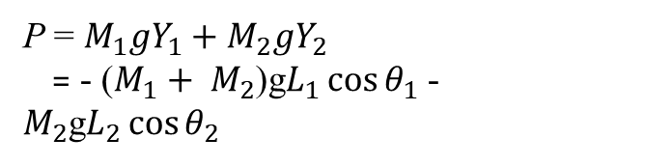
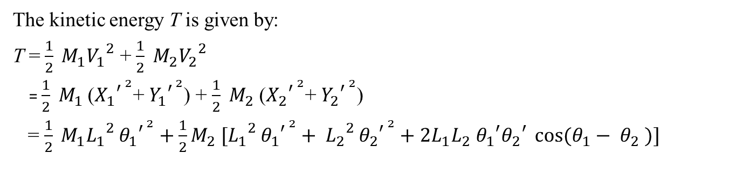
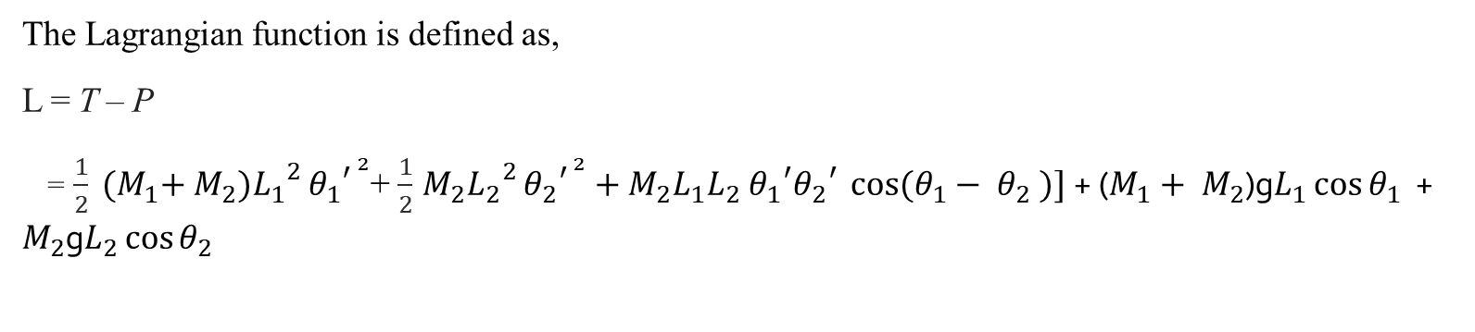
The kinetic energy T is given by:
T = $\frac{1}{2} M_{1}{V_{1}}^{2}$ + $\frac{1}{2} M_{2}{V_{2}}^{2}$
= $\frac{1}{2} M_{1}$(${X_{1}}^{{′ }^{2}}$+ ${Y_{1}}^{′^{ 2}}$) + $\frac{1}{2} M_{2}$ (${X_{2}}^{{′ }^{2}}$+ ${Y_{2}}^{{′ }^{2}}$)
= $\frac{1}{2} M_{1}{L_{1}}^{2 }{θ_{1}}^{{′ }^{2}}+\frac{1}{2}M_{2} [{L_{1}}^{2 }{θ_{1}}^{{′ }^{2}}+ {L_{2}}^{2 }{θ_{2}}^{{′ }^{2}}+2L_{1}L_{2} {θ_{1}}^{′}{θ_{2}}^{′} \cos{(θ_{1}− θ_{2} )}]$
The potential energy of the system is given by,
P = $M_{1}gY_{1}+M_{2}gY_{2}$
= - ($M_{1}+ M_{2}$)g$L_{1}\cos{θ_{1}}$ - $M_{2}$g$L_{2}\cos{θ_{2}}$
The Lagrangian function is defined as,
L = T – P
= $\frac{1}{2} {(M}_{1}+ M_{2}){L_{1}}^{2 }{θ_{1}}^{{′ }^{2}}$+ $\frac{1}{2}$ $M_{2}{L_{2}}^{2 }{θ_{2}}^{{′ }^{2}}+{M_{2}L}_{1}L_{2} {θ_{1}}^{′}{θ_{2}}^{′} \cos{(θ_{1}− θ_{2} )}]$ + ($M_{1}+ M_{2}$)g$L_{1}\cos{θ_{1}}$ + $M_{2}$g$L_{2}\cos{θ_{2}}$

Slide 13
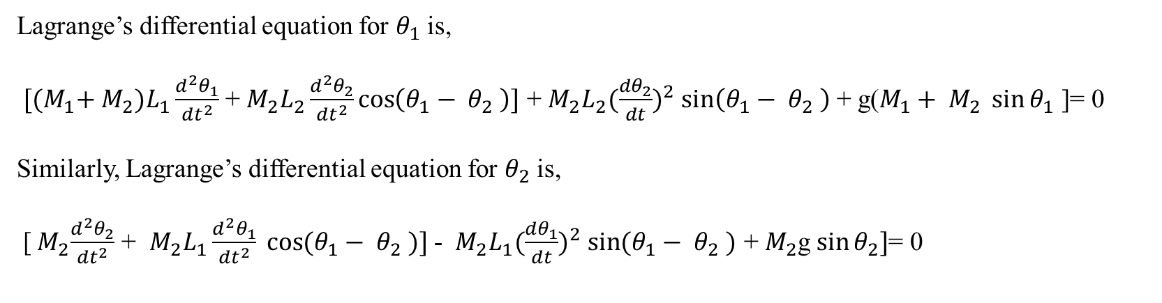

The Euler-Lagrange equation in terms of generalized coordinates can be expressed as:
$$\frac{d}{dt}\left(\frac{∂L}{∂{θ^{′}}_{i}}\right)− \frac{∂L}{∂{θ^{′}}_{i}}=0$$
Lagrange’s differential equation for $θ_{1}$ is,
${[(M}_{1}+ M_{2})L_{1}\frac{d^{2}θ_{1}}{{dt}^{2}}$ + $M_{2}L_{2}\frac{d^{2}θ_{2}}{{dt}^{2}}\cos\left(θ_{1}− θ_{2} \right)]$ + $M_{2}L_{2}{(\frac{{dθ}_{2}}{dt})}^{2}$ $\sin\left(θ_{1}− θ_{2} \right)$ + g($M_{1}+ M_{2} \sin{θ_{1}}$ ]= 0
Similarly, Lagrange’s differential equation for $θ_{2}$ is,
[${ M}_{2}\frac{d^{2}θ_{2}}{{dt}^{2}}$ + ${{ M}_{2}L}_{1}\frac{d^{2}θ_{1}}{{dt}^{2}} \cos{(θ_{1}− θ_{2} )}]$ - ${{ M}_{2}L}_{1}{(\frac{{dθ}_{1}}{dt})}^{2}$ $\sin{(θ_{1}− θ_{2} )}$ + $M_{2}$g$\sin{θ_{2}}]$= 0

Slide 14
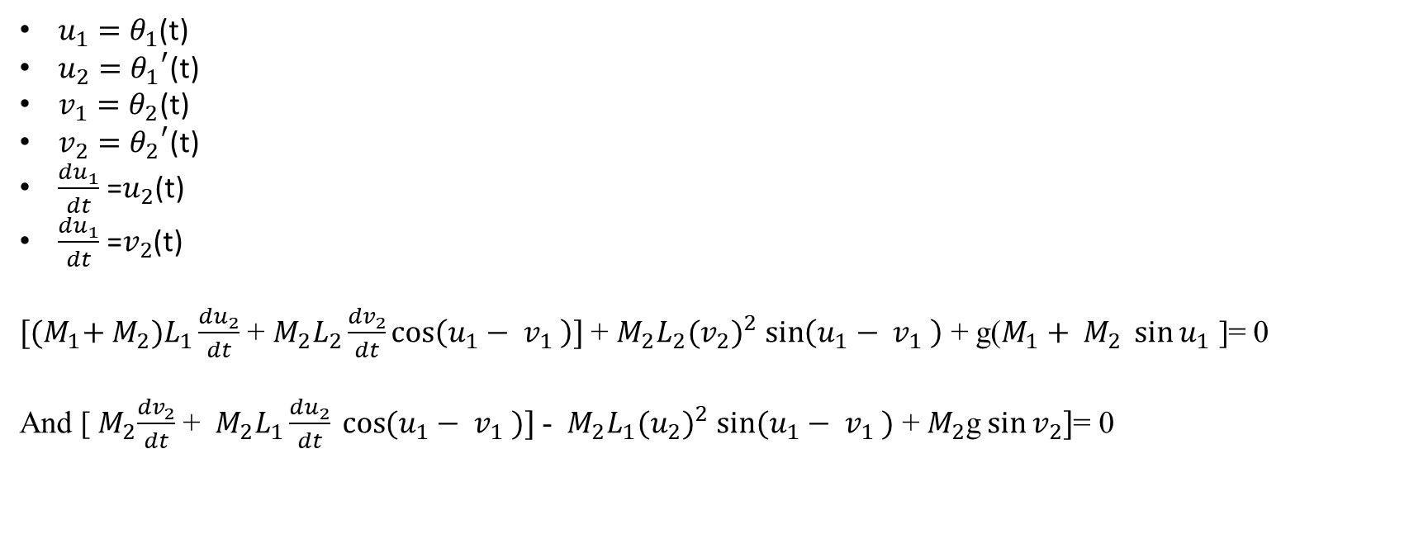
Simplification of solution
To simplify the equations to run in the, MATLAB we can use these below variables,
$u_{1}=$ $θ_{1}$(t)
$u_{2}=$ ${θ_{1}}^{′}$(t)
$v_{1}=θ_{2}$(t)
$v_{2}={θ_{2}}^{′}$(t)
$\frac{{du}_{1}}{dt}$ =$u_{2}$(t)
$\frac{{du}_{1}}{dt}$ =$v_{2}$(t)
${[(M}_{1}+ M_{2})L_{1}\frac{{du}_{2}}{dt}$ + $M_{2}L_{2}\frac{{dv}_{2}}{dt}\cos\left(u_{1}− v_{1} \right)]$ + $M_{2}L_{2}({v_{2})}^{2}$ $\sin\left(u_{1}− v_{1} \right)$ + g($M_{1}+ M_{2} \sin{u_{1}}$ ]= 0
And [${ M}_{2}\frac{{dv}_{2}}{dt}$ + ${{ M}_{2}L}_{1}\frac{{du}_{2}}{dt} \cos{(u_{1}− v_{1} )}]$ - ${{ M}_{2}L}_{1}{(u_{2})}^{2}$ $\sin{(u_{1}− v_{1} )}$ + $M_{2}$g$\sin{v_{2}}]$= 0

Slide 15
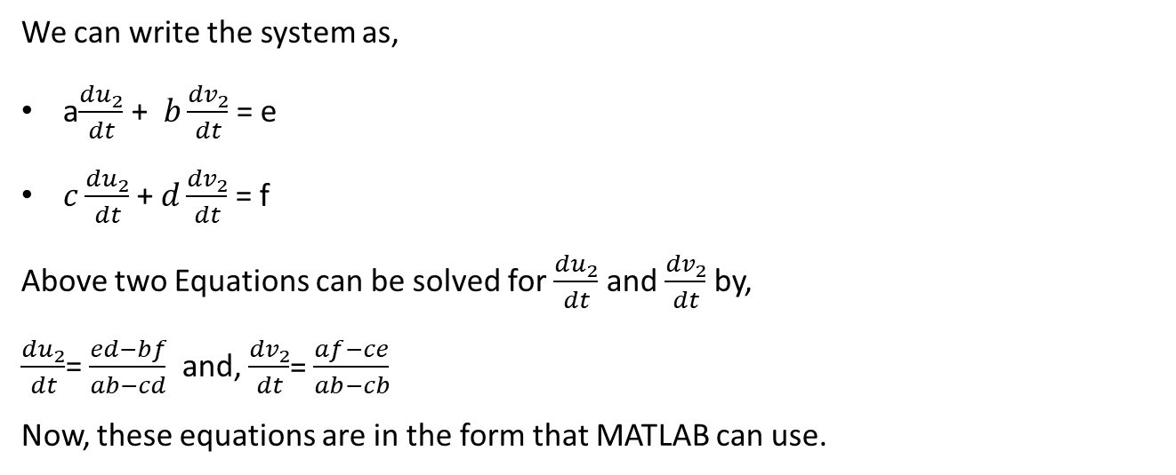
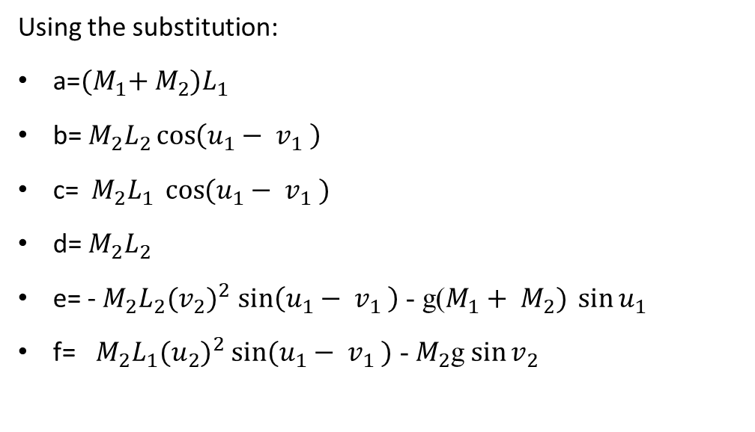
Using the substitution:
a=${(M}_{1}+ M_{2})L_{1}$
b= $M_{2}L_{2}\cos\left(u_{1}− v_{1} \right)$
c= ${{ M}_{2}L}_{1} \cos{(u_{1}− v_{1} )}$
d= $M_{2}L_{2}$
e= - $M_{2}L_{2}({v_{2})}^{2}$ $\sin\left(u_{1}− v_{1} \right)$ - g($M_{1}+ M_{2}) \sin{u_{1}}$
f= ${{ M}_{2}L}_{1}{(u_{2})}^{2}$ $\sin{(u_{1}− v_{1} )}$ - $M_{2}$g$\sin{v_{2}}$
We can write the system as,
a$\frac{{du}_{2}}{dt}$ + $b\frac{{dv}_{2}}{dt}$ = e
$c\frac{{du}_{2}}{dt}$ + $d\frac{{dv}_{2}}{dt}$ = f
Above two Equations can be solved for $\frac{{du}_{2}}{dt}$ and $\frac{{dv}_{2}}{dt}$ by,
$\frac{{du}_{2}}{dt}$= $\frac{ed−bf}{ab−cd}$ and, $\frac{{dv}_{2}}{dt}$= $\frac{af−ce}{ab−cb}$
Now, these equations are in the form that MATLAB can use.

Slide 16
Implementation
We have used MATLAB 2020a for implementing our project.
we have used the following pendulum parameters,
L₁ =2, L₂=4
m₁= 4, m₂= 2
g = 9.8
The initial conditions is as follows,
u₁ = 1.5 u₂(0) = 0.0v₁(0) = 3.0 v₂(0) = 0.0

Slide 17
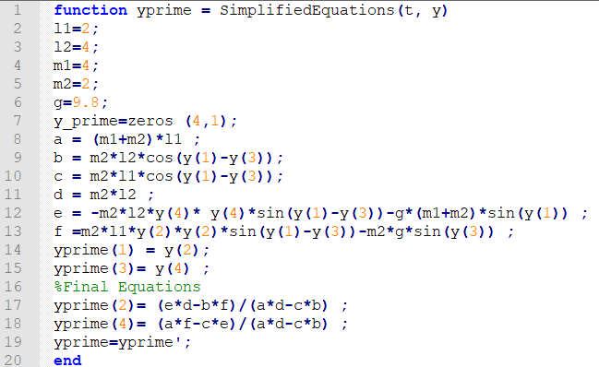

Slide 18
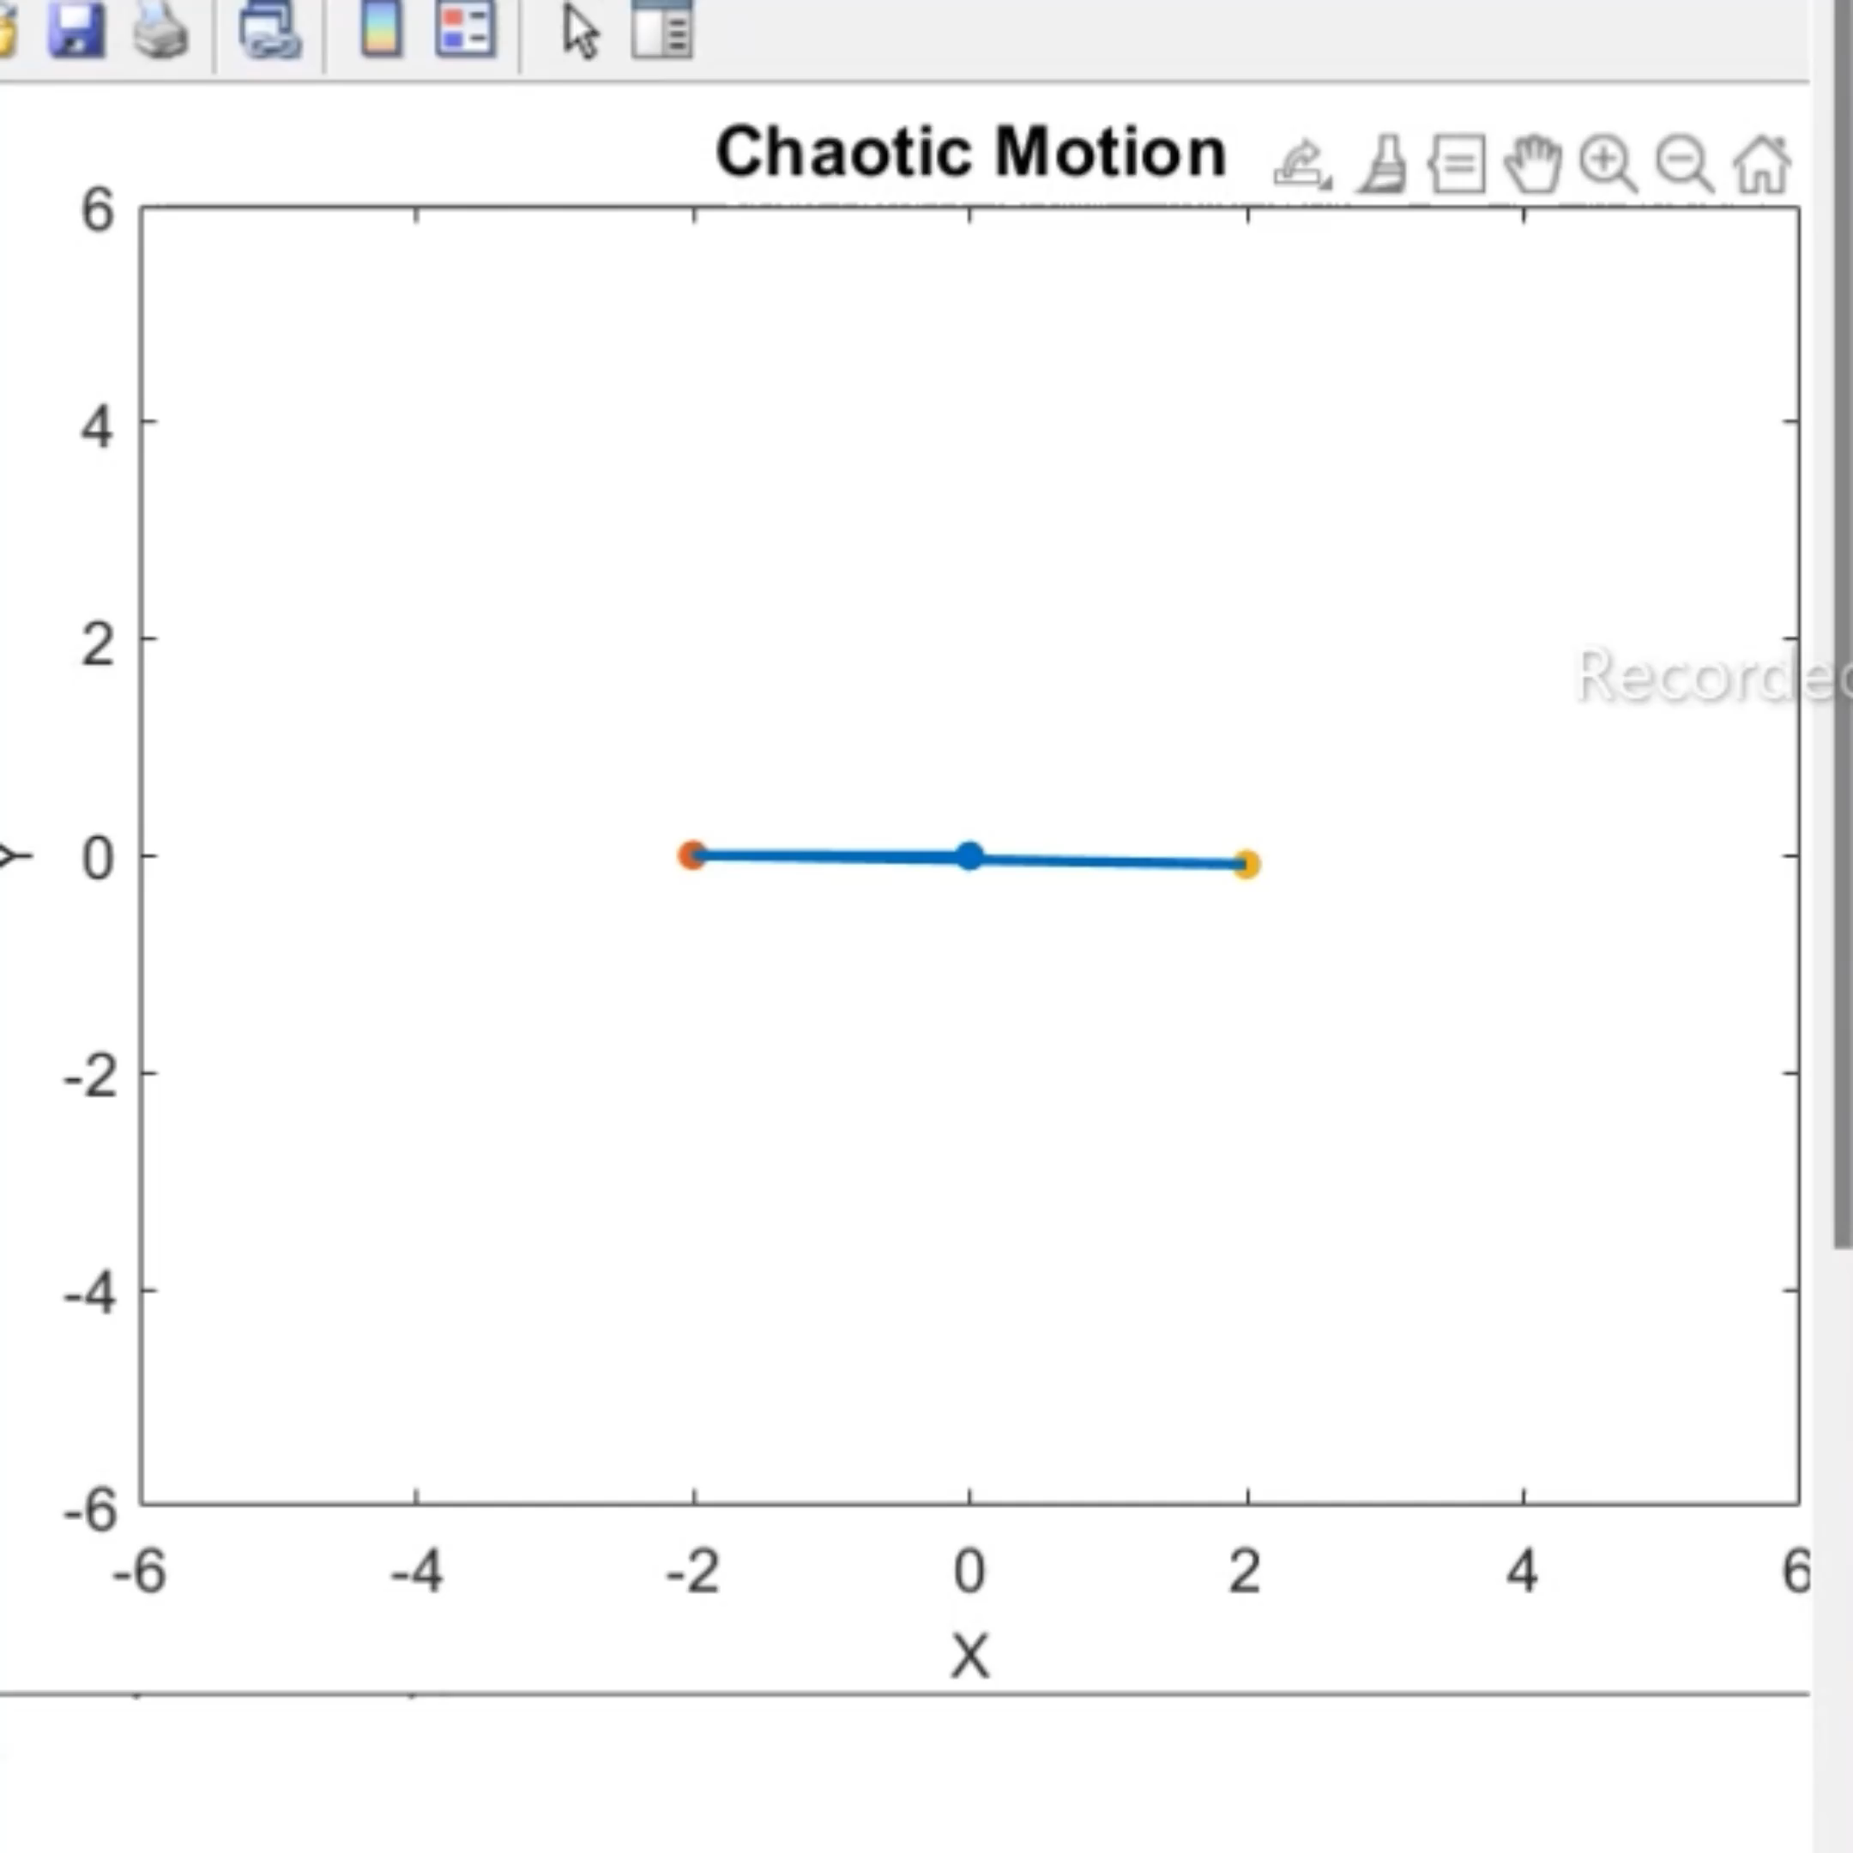
When have also implemented the animation, chaotic behaviour of the double pendulum and also the plot of theta1 vs theta2 at initial values 3 and 1.5 respectively.

Slide 19
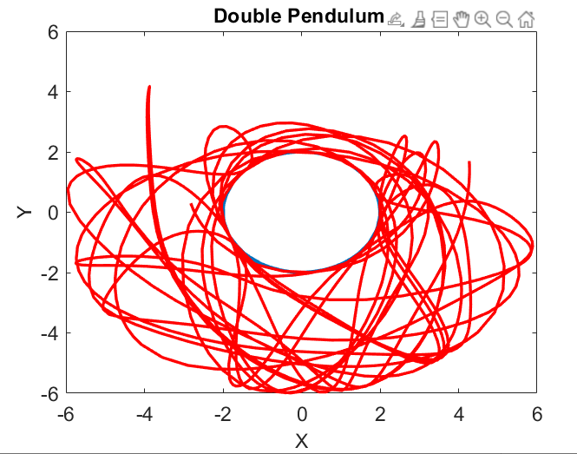
chaotic behavior of the double pendulum.

Slide 20
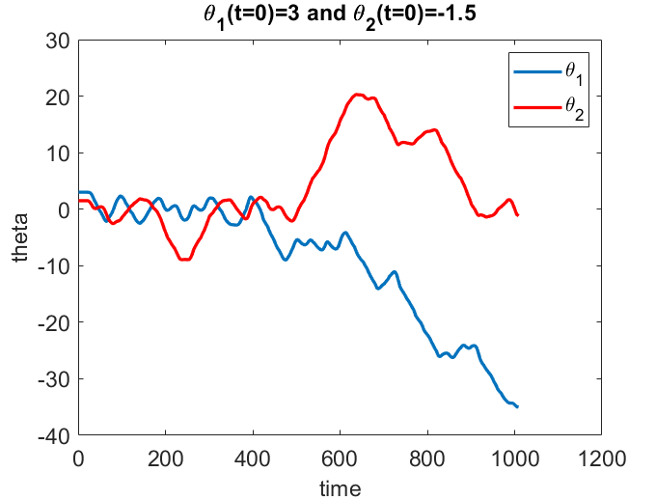
Initial angles are theta1 = 3.0 and theta2 = 1.5
For the initial few seconds the behaviour looks the same.
After some time passes we can see the drastic changes.

Slide 21
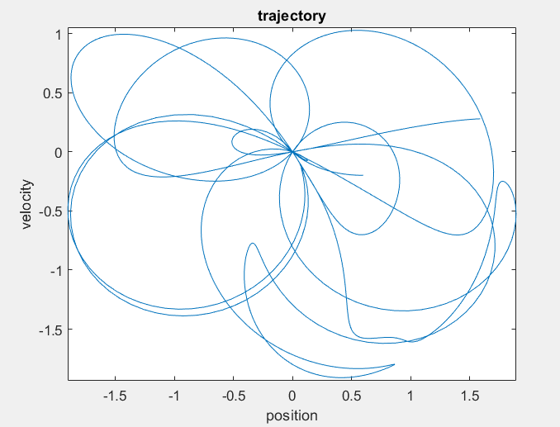
PointCare
PointCare.m gives us insights into the dynamics of our project.
To construct this two-dimensional PointCare we take theta2 = 0 (whenever the pendulum passes vertical state). so that we get theta1 plot.

Slide 22
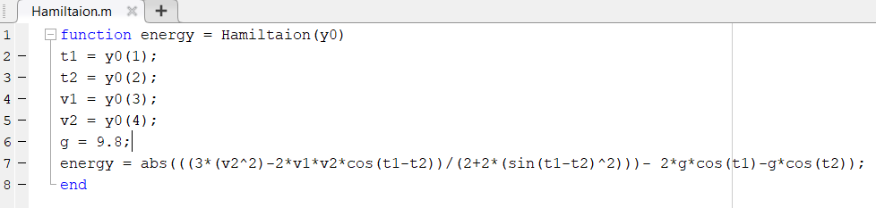
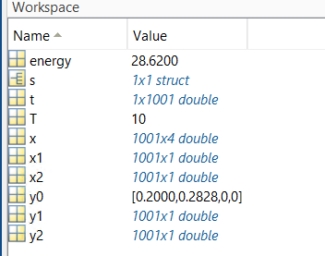
Hamilton
Using a Hamiltonian with low energy conditions we can easily calculate the energy in joules.
Example: y0[θ1, θ2, Pθ1, Pθ2] = [0.2,0.2828,0,0], the energy = 28.620.
at this low energy we can easily predict the behaviour of the system.

Slide 23
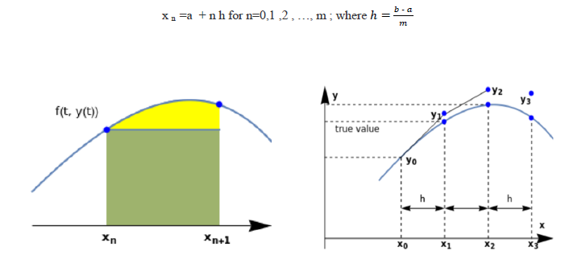
EULER’S METHOD
The slope at the beginning of the interval is taken as an approximation of the average slope over the whole interval, this approximation is called Euler's method.
y′=f(x, y) , y(x0)=y0
Euler method or the tangent line method is used for solving numerically the initial value problem.
yn+1 = yn + h f(xn, yn).

Slide 24
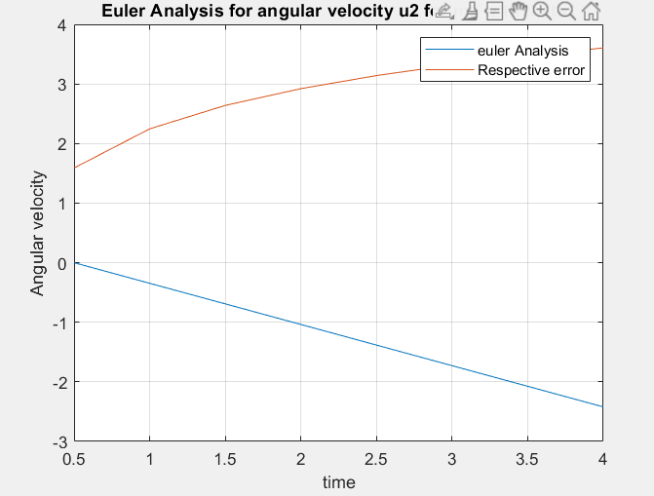
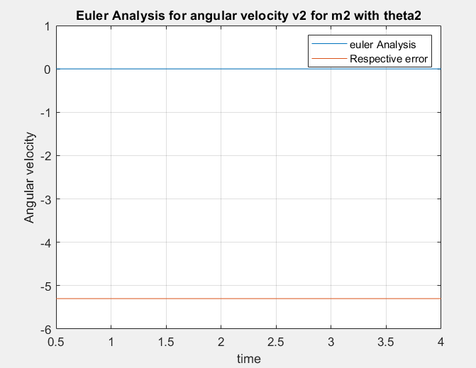

Slide 25
Euler’s analysis for angular velocity v2
LE= log(error2)
LH= log(x) x=0.5:h:4
Dr= LH (end) – LH (1)
Nr= LE (:, end) – LE (:,1)
Slope = Nr / Dr
Euler analysis for angular velocity u2
LE= log(error1)
LH= log(x) x=0.5:h:4
Dr= LH (end) – LH (1)
Nr= LE (:, end) – LE (:,1)
Slope = Nr / Dr

Slide 26
